Slide 1
Notes:
Basic things;
Name of artist, song, record company, year of release
Genre of music
Media language – is it fairly typical of the genre? In terms of camera, editing palette, narrative, is it very unusual?
Audience – who are the audiences? (Age, gender, demographics, psychographics…) How is appeal being constructed (uses and gratifications – diversion, personal identity, social identity, surveillance.)

Slide 2
Project Notes
Representation: Who is being represented? Dominant or alternative representations? Typical for the genre? Are there issues of gender or ethnic representation? Or age, nationality? Is Male Gaze relevant? Is the virgin/ whore dichotomy helpful? Is there any tokenism? Is a star persona being constructed – can we use star theory?
FINALLY – choose how to present your work You have three options.
Create a set of notes, like the notes on the Black Eyed Peas video on kgvmedia.com

Slide 3
Project Notes
Make a powerpoint/ keynote
Download the youtube video , put it in your editing program of choice, and apply text to annotate it. Feel free to get ambitious with this – make it into a documentary, aply a voiceover, stop and start the video if need be.
LETS GET STARTED

Slide 4
Recap
Denotation
Connotation
Dominant Representation
Buscombes Theory
Representation of Gender/Race

Slide 5
Representation of Gender
When we look at how different people are represented, one of the most basic areas to look at is Gender
Particular femininity, is represented in the media has become an extremely controversial topic.

Slide 6
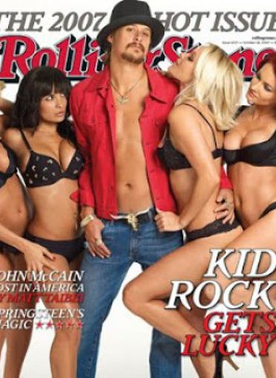
Typical Representation
Here's an exaggerated but fairly typical example of the way that women often get represented in mainstream Western media.
Task: Denotate all you can from the image then discuss its connotations

Slide 7
Clearly, the women here are being sexualised.
They are all conventionally attractive and assocaited with the iconography of willing sexuality - young, with long hair, good skin and dressed in black lingerie, so they offer a DOMINANT REPRESENTATION of attractiveness.
Kid Rock's confidence and bravado suggest a dominant representation of masculinity.

Slide 8
Additionally, however, the women are shown to be rather subservient and PASSIVE.
They depend on the man; they are eager for his attention, and he meanwhile is very superior in the way he ignores them.
The shot contributes to this - he gets to be more or less clothed, while they don't, and he gets to look at the camera (connoting confidence) while they only get to look at him.
Finally, the women on the left is stroking the woman beside her. This suggestion of lesbianism seems designed to offer gratification to a male audience; there is no chance we will ever see, for example, Kid Rock stroking another man in order to gratify a female audience.

Slide 9
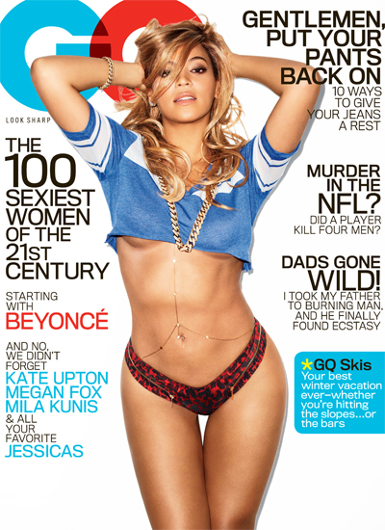
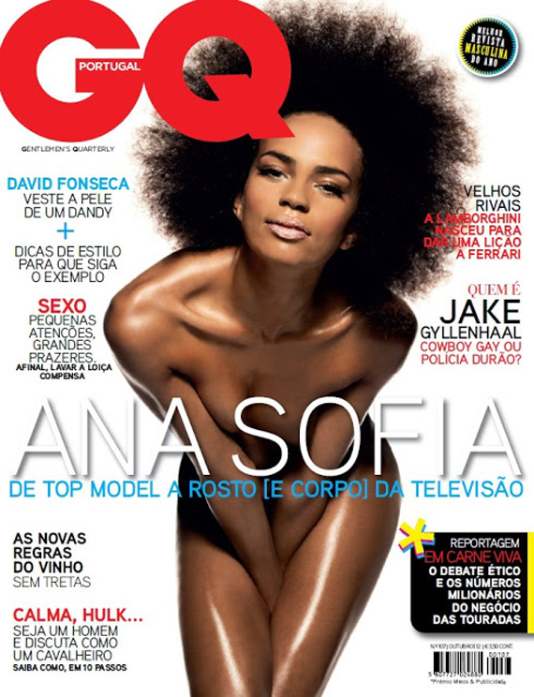
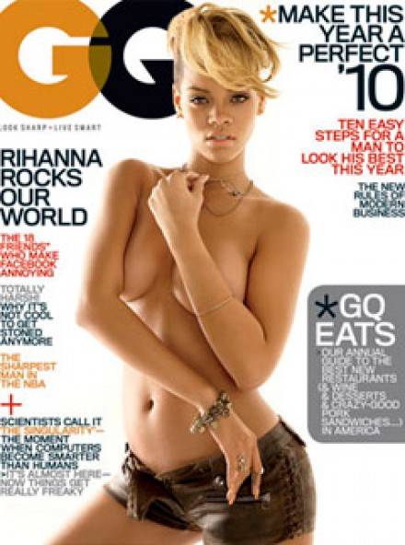

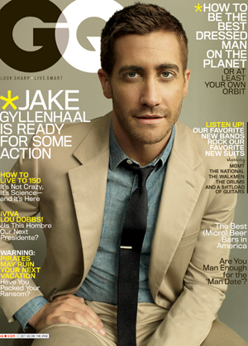
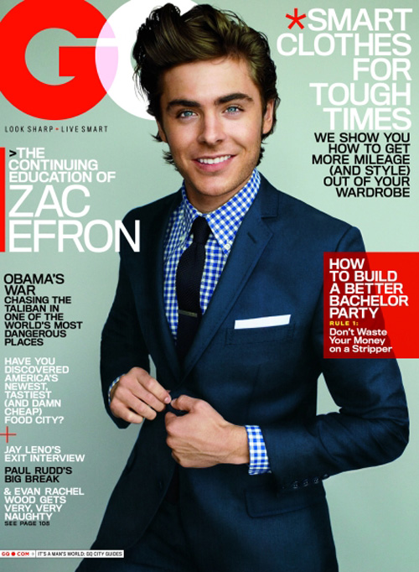

Slide 10
Active & Passive
Common complaint is that men are often seen as active, central characters
Women are passive and secondary.
In traditional Proppsian narratives of, course, the only character type who is generally female is the very passive damsel and distress.
Not much has changed, it could be argued.
TASK: PROPPS THEORY – What is it again??????

Slide 11
Dominant Representation of Women
Women, clearly, are often judged primarily on their physical attractiveness and 'attractiveness' itself is not a flexible concept
‘Attractive' women are thin, often with exaggerated sexual characterisitics (breasts, buttocks, even lips), with long glossy hair and perfect skin.
This is a dominant representation; it is what is 'normal' in the media.

Slide 12
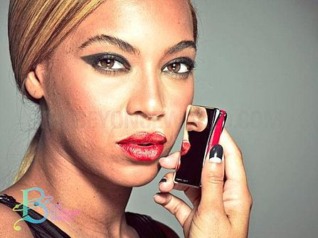
Artificiality removed can cause uproar – Why?
Largely impossible for most women to achieve or even come close to this sort of perfection
When the artificiality of it is revealed, it can cause uproar.
When the unphotoshopped image of Beyonce, above on the right, was released, showing that her skin was actually pretty much the same as that of most people, it was considered worthy of much attention.

Slide 13
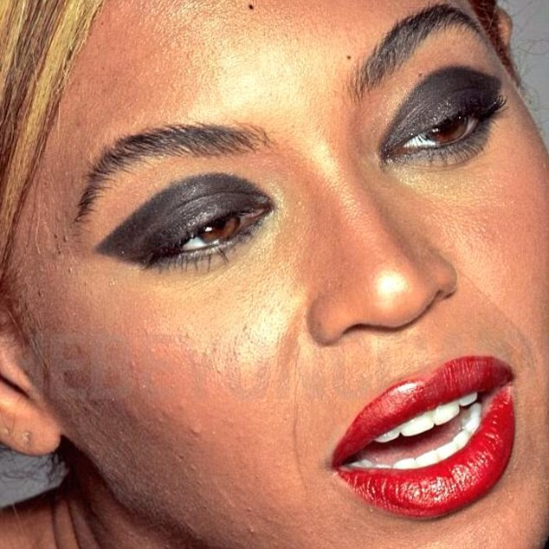
What are YOUR perceptions NOW?

Slide 14
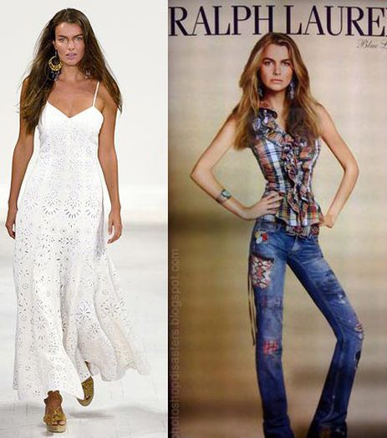
Insistence in Media that Women must be Beautiful:
The Ralph Lauren advert on the right famously Photoshopped a model (also seen unphotoshopped on the left) to the point where her head was actually wider than her pelvis.
can become a problem if audiences, particularly younger, more vulnerable audiences, don't realise that they are actually impossible to replicate in real life.
TASK: What can you find me on the concept of Audience Modelling?

